Slide 1


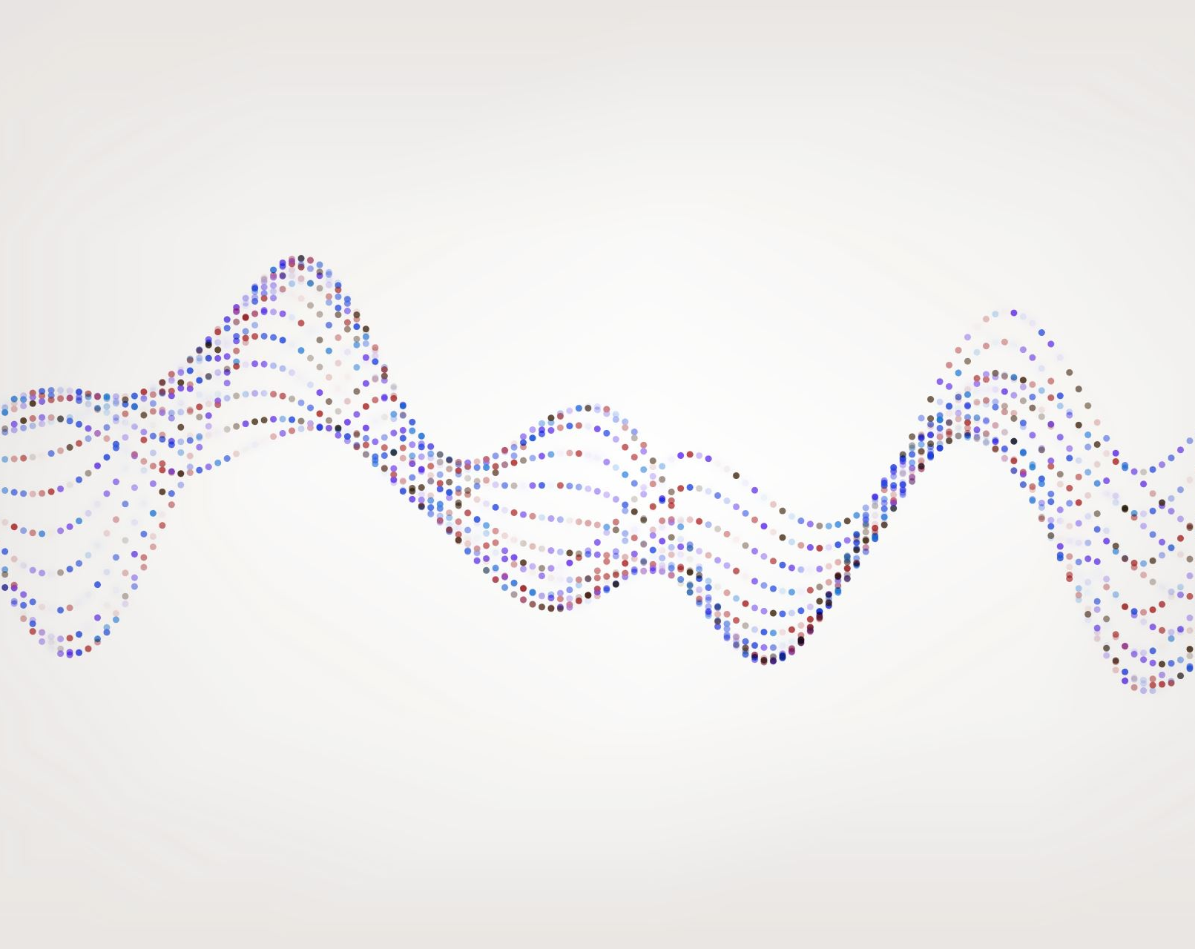



BBQS-CAMERA
A Brain Behavior Quantification and Synchronization for Context-Aware Multimodal Ecological Research and Assessment

Slide 2
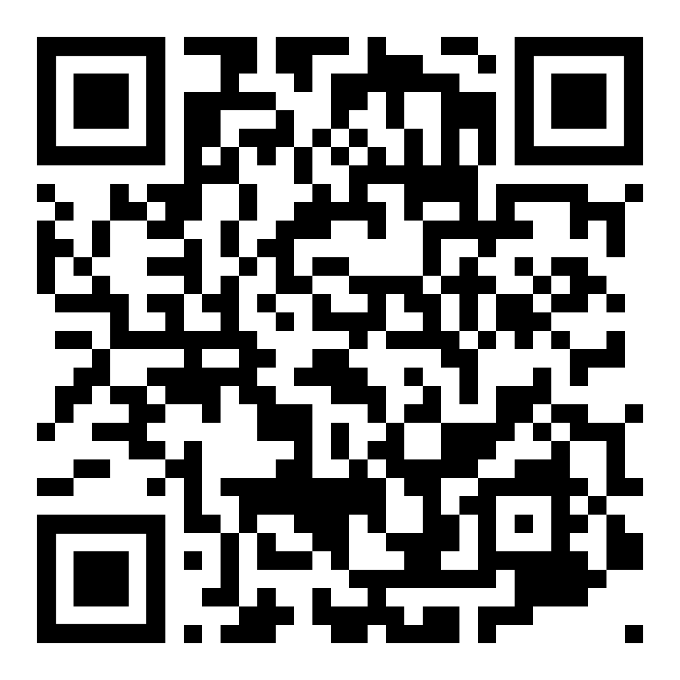
Project Overview
Goals:
Development of multimodal models for inference of anxiety levels
Studying the human brain–behavior relationships
Data Streams:
Physiological indicators
Neural signals
Behavioral signals
Environmental indicators
Ecological Momentary Assessments (EMAs)

Slide 3
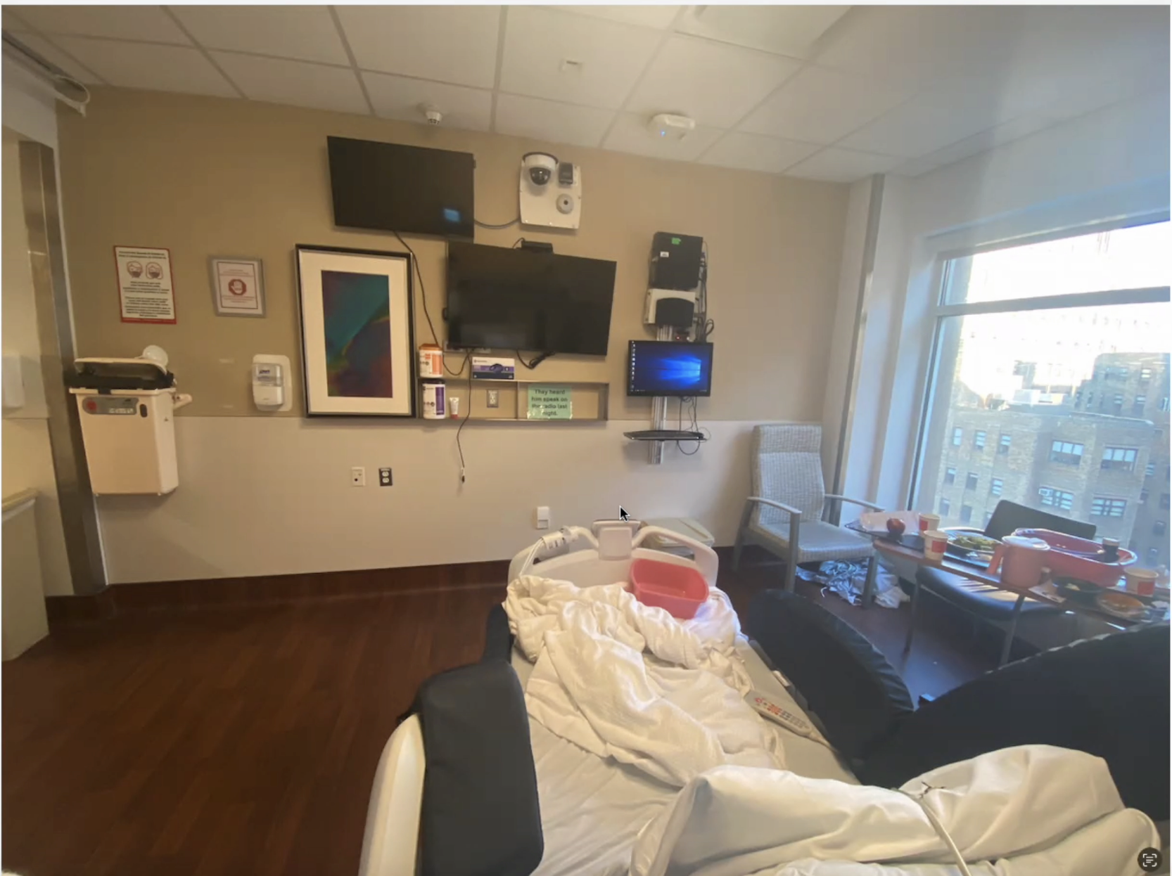
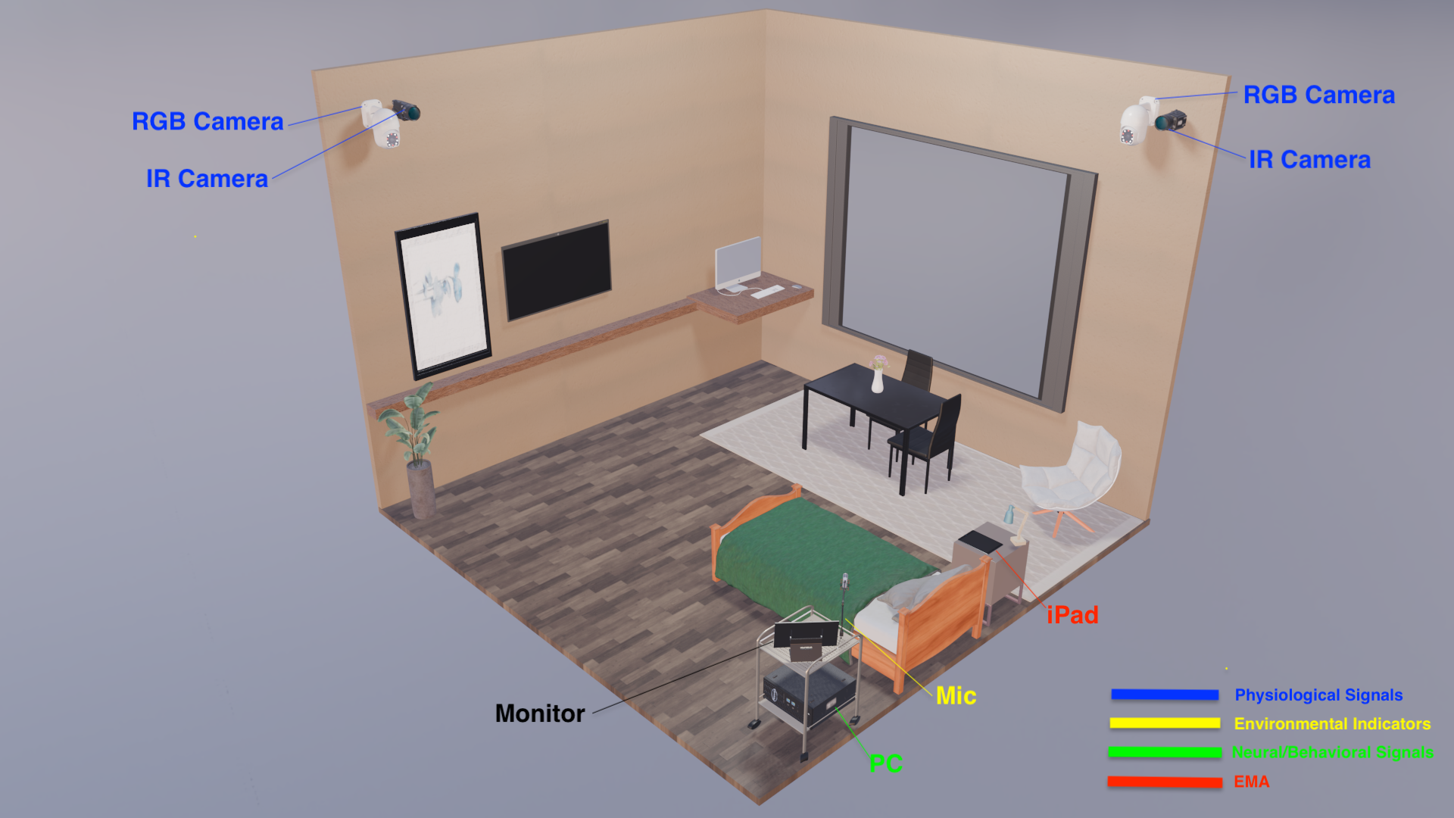
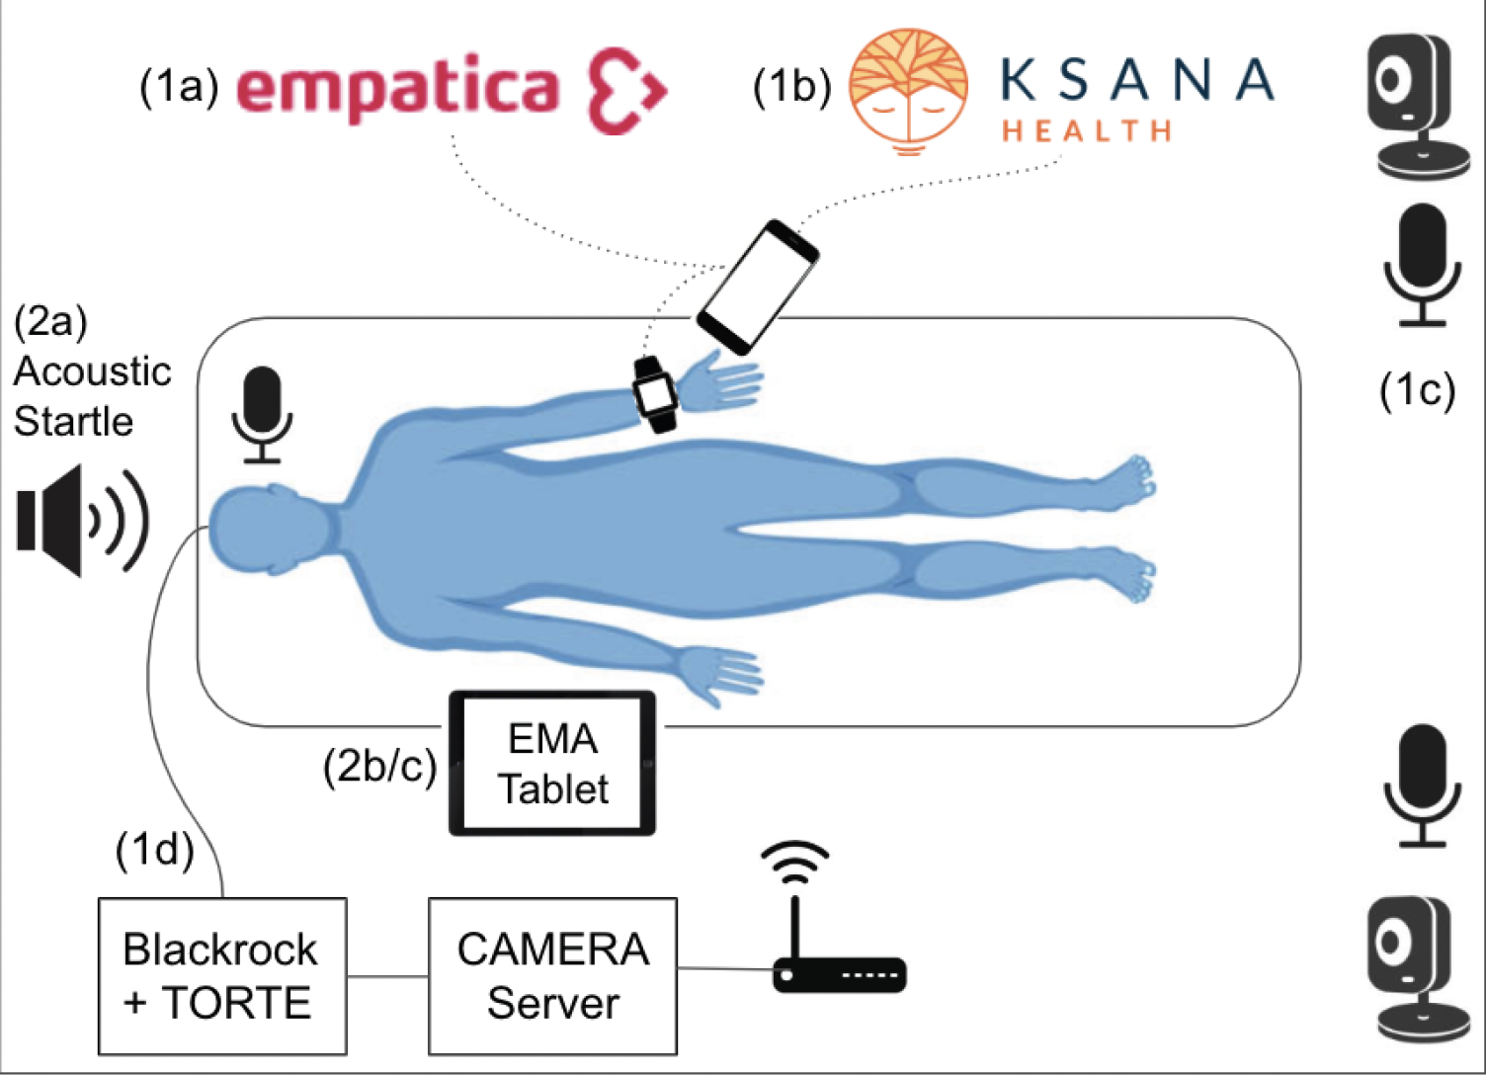
Study Setup
Actual hospital room
360-view of the hospital room
Patient setup

Slide 4
Phase 1
CAMERA Framework Development
Aim 1:
Develop CAMERA hardware/software framework
Include methods for recording continuous neural, physiologic, audiovisual, and smartphone-usage data in the framework
Aim 2:
Synchronize recorded sensor signals with intermittent Ecological Momentary Assessments (EMA)
Aim 3:
Demonstrate CAMERA's ability to combine multimodal features
Predict subject's anxiety state and memory efficiency using CAMERA

Slide 5
DEMO

Slide 6




Future Directions
Expanded Data Sources:
Camera and infrared imagery
Ecological momentary assessments
Direct brain probe data
Ambient noise
Integration Goal: Combine diverse data into a learning model
Outcome:
Inference of behavioral biomarkers of anxiety
Advancing mental health diagnostics

Slide 7


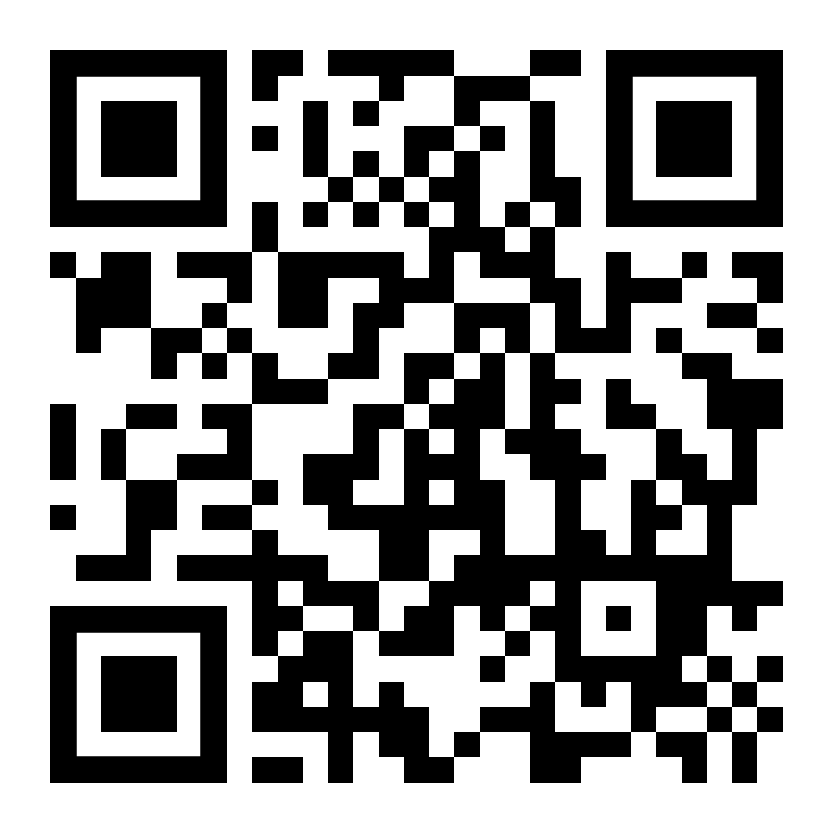
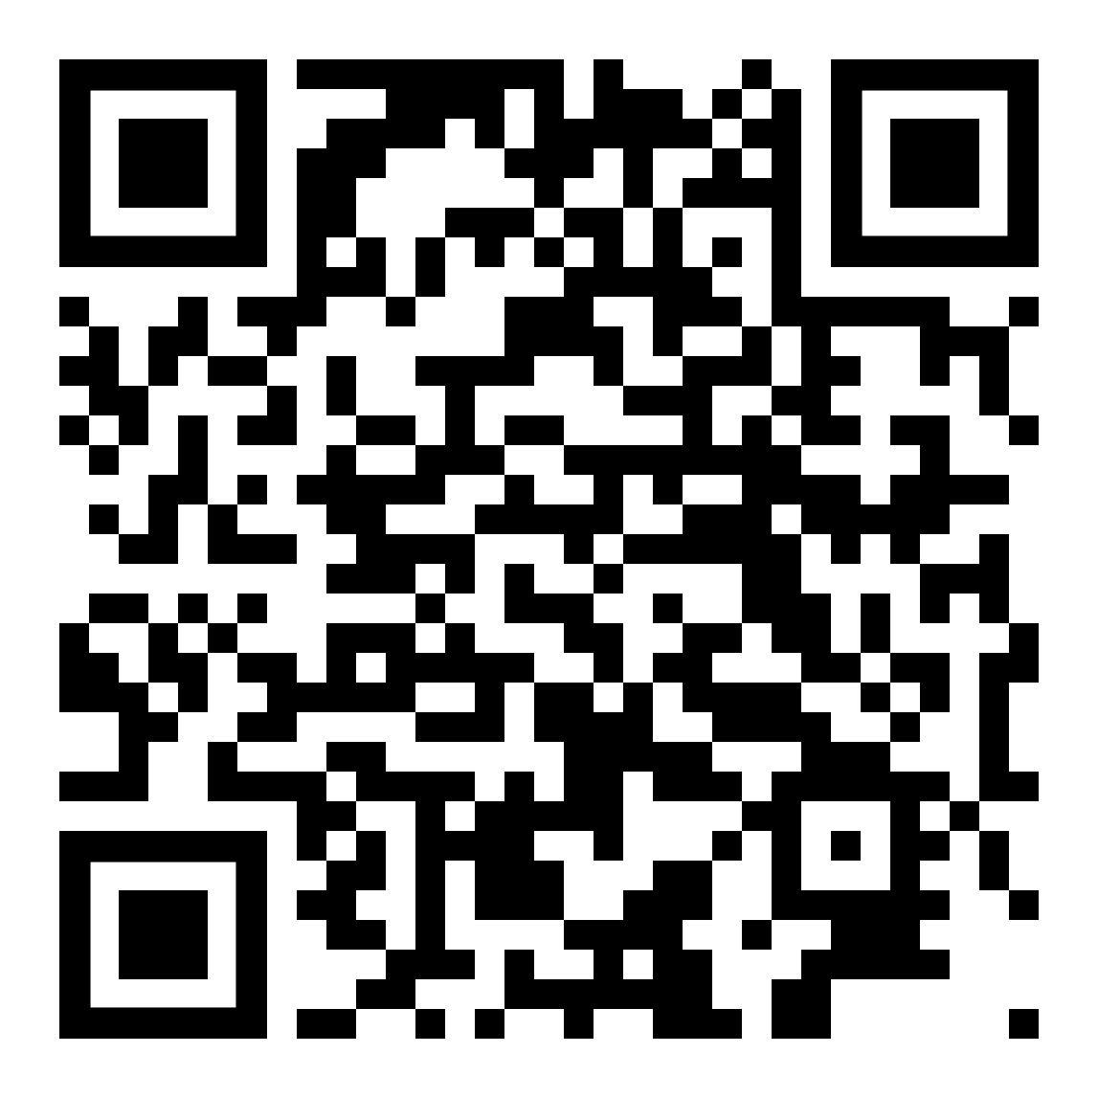
Thank you!
Taqiya Ehsan
te137@rutgers.edu
Shuren Xia
sx67@rutgers.edu

